Slide 1
Live-Virtual-Constructive (LVC) Federation Engineering
Marine Corps M&S Management Office (MCMSMO)
Presented by Katherine L. Morse, PhD
JHU/APL
27 August 2015
Unclassified//U
Notes:
This class instructs the student on the topic of LVC federation engineering and the issues that arise in this process.

Slide 2
Class Outline
Training goal and objectives
Federation engineering standards
Federation engineering issues
Notes:
This class has three topics. First, we will review the training goal and objectives. Then we will review existing federation engineering standards and discuss how they apply to engineering live-virtual-constructive federations. The bulk of the class describes individual federation engineering issues, the circumstances under which they may arise, their potential impacts, and resources or references for learning more about the issues.

Slide 3
Training Goal
Problem - The possibility exists that many disparate and isolated LVC related efforts occurring within the Department of the Navy (DoN) may produce incompatible solutions (both amongst themselves and with other Joint solutions) which will:
  Create duplicative capabilities,
  Consume limited DoN resources, and
  Introduce unnecessary technical and operational risks.
Solution - Educate LVC users to make informed decisions based on knowledge of LVC:
  Terminology
  LVC Federation Engineering
  Technologies
  Policy and stakeholders
Notes:
The purpose of this training is to address the problem of many disparate and isolated LVC related efforts within the Department of Navy that may and do produce incompatible solutions both amongst themselves and with other joint solutions. This problem results in duplicative capabilities that consume limited Department of Navy resources, and introduce unnecessary technical and operational risks. The solution to this problem is to educate LVC procurers to make informed decisions based on knowledge of LVC. This particular class focuses on LVC federation engineering. Terminology technologies, and policy and stakeholders are covered in other classes in this course.

Slide 4
Training Objectives
Learn to make informed decisions based on knowledge of LVC
  ELO 1: Demonstrate familiarity with LVC federation engineering processes and standards.
  ELO 2: Identify federation engineering issues to address when applying and integrating LVC technologies.
Notes:
The primary training objective for this class is to learn to make more informed decisions based on knowledge of LVC. The two enabling learning objectives for this are: to demonstrate familiarity with LVC federation engineering processes and standards, and to identify federation engineering issues to address when applying and integrating LVC technologies.

Slide 5
Return on Investment (ROI) for Applying Federation Engineering Standards
Standards produced by internationally recognized standards development organizations (SDOs) receive input and review from subject matter experts (SMEs) in the field, ensuring comprehensiveness and quality.
  Reducing errors that consume limited DoN resources, and introduce unnecessary technical and operational risks.
Adopting such standards enables consistency of understanding and application across team members.
  Reducing the probability of misunderstandings that introduce unnecessary technical risks.
The standards applied in this class are developed and maintained by the Simulation Interoperability Standards Organization (SISO), the only SDO devoted solely to simulation standards.
  Applying SISO standards improve the probability of creating interoperable rather than duplicative capabilities.
Notes:
The purpose of applying federation engineering standards is that these standards produce a return on investment (ROI) consistent with addressing the problems outline in this class’ training goal. The standards discussed in this class are produced by internationally recognized SDOs where they receive input and review from SMEs in the field, ensuring comprehensiveness and quality. This ties back to the training goal of reducing the probability of misunderstandings that introduce unnecessary technical risks because these standards provide clear and unambiguous guidance understandable by all team members. The standards applied in this class are developed by SISO, the only SDO devoted solely to simulation standards, once again tying back to the training goal. Applying the standards improves the probability of creating interoperable rather than duplicate capabilities because SISO standards focus solely on simulation interoperability.

Slide 6
Federation Engineering Standards
Distributed Simulation Engineering and Execution Process (DSEEP)
  An architecture-neutral, high-level process framework into which the lower-level systems engineering practices native to any distributed simulation user can be easily integrated.
  Applies to federation engineering in a single-architecture environment.
  DSEEP will be used to walk through the “how” of LVC.
DSEEP Multi-Architecture Overlay (DMAO)
  A recommended practice for applying the DSEEP to the development and execution of distributed simulation environments that include more than one distributed simulation architecture.
  DMAO will be used to identify typical major issues that arise in Department of Defense (DoD) LVC.
Notes:
We will apply three federation engineering standards in this class. The first is the Distributed Simulation Engineering and Execution Process (DSEEP). The DSEEP is an architecture neutral high-level process framework into which the lower-level systems engineering practices native to any distributed simulation developer can be integrated easily. The DSEEP applies to federation engineering in a single architecture environment. The DSEEP will be used to walk through the “how” of LVC, i.e. what are the steps, tasks, and activities necessary to successfully engineer a distributed simulation environment.
The DSEEP has an overlay, the DSEEP Multi-Architecture Overlay (DMAO) that focuses on identifying the typical, major issues that arise in developing LVC environments. The DMAO differs from the DSEEP in that it assumes that you are working in a multi-architecture environment rather than a single architecture environment. Its focus is on issues that arise as a result of integrating and interoperating between architectures.

Slide 7
Federation Engineering Standards
Federation Engineering Agreements Template (FEAT)
  An XML schema designed for recording all federation agreements of use to federation developers and participants.
  Serves as a format for recording agreements as well as a guide to identifying agreements necessary to complete and successful federation engineering.
  FEAT will be used to document all decisions made during LVC federation engineering.
Notes:
The third standard being applied is the Federation Engineering Agreements Template (FEAT). FEAT is an XML schema designed for recording all federation agreements of use to federation developers and participants. It serves as both a format for recording agreements as well as a guide to identifying agreements necessary to complete and successful federation engineering. The FEAT is used to document all decisions made during LVC federation engineering.

Slide 8
DSEEP Top Level View
The DSEEP was developed based on several, widely-adopted, authoritative systems engineering processes.
These processes were adapted and extended to address engineering requirements unique to distributed simulations.
Define Simulation Environment Objectives
Perform Conceptual Analysis
Design Simulation Environment
Develop Simulation Environment
Integrate
and Test Simulation Environment
Execute Simulation
Analyze Data and Evaluate Results
1
2
3
4
5
6
7
Corrective Actions / Iterative Development
Notes:
This slide provides a top level view of the DSEEP. Because the DSEEP is fundamentally a systems engineering process for distributed simulation environments, it was developed based on several, widely-adopted authoritative systems engineering processes. If you are a systems engineer, you will probably be able to align the DSEEP with your favorite systems engineering process. These authoritative systems engineering processes were adapted and extended to address engineering requirements unique to distributed simulations. Although this course does not review the DSEEP in detail, you can see the fundamentals of all systems engineering processes in its steps such as defining objectives designing the environment, developing the environment, integrating and testing the environment, using the environment, and analyzing data and evaluating results.

Slide 9
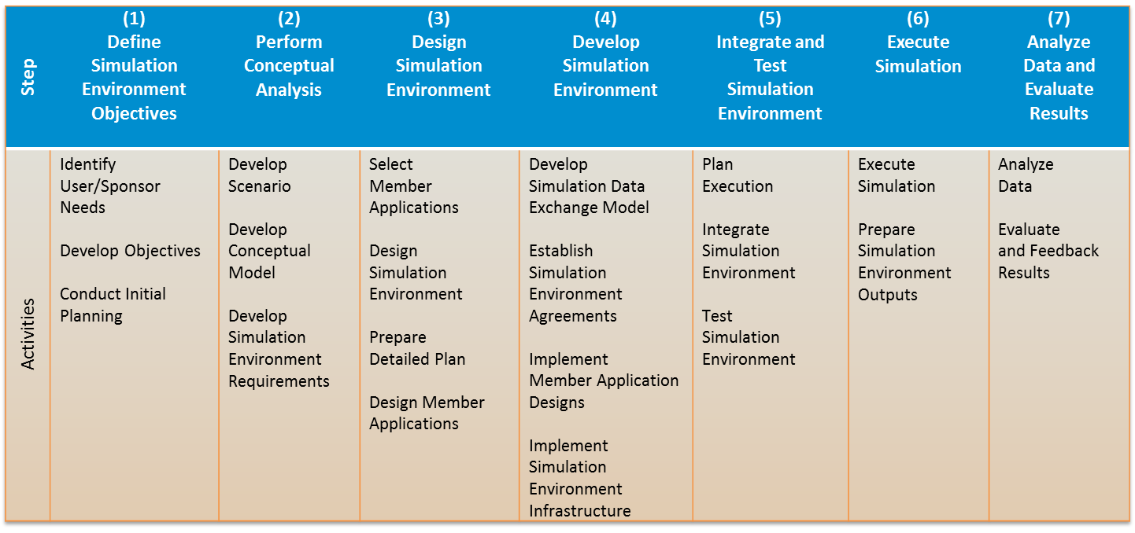
DSEEP Activities
Each major step of the DSEEP consists of multiple activities, each of which has multiple inputs, tasks, and outcomes that must be evaluated during federation engineering.
Notes:
As illustrated on the preceding slide, the DSEEP has seven major steps. Within each step there are 2 to 4 activities. Each of these activities is subsequently decomposed into multiple inputs, tasks, and outcomes that must be evaluated during federation engineering. This does not mean that each of these activities and tasks must be performed, but each of them should be evaluated for applicability to the target simulation environment. Like all good systems engineering processes, the DSEEP should be tailored to the particular problem, and other engineering and management processes for the project.

Slide 10
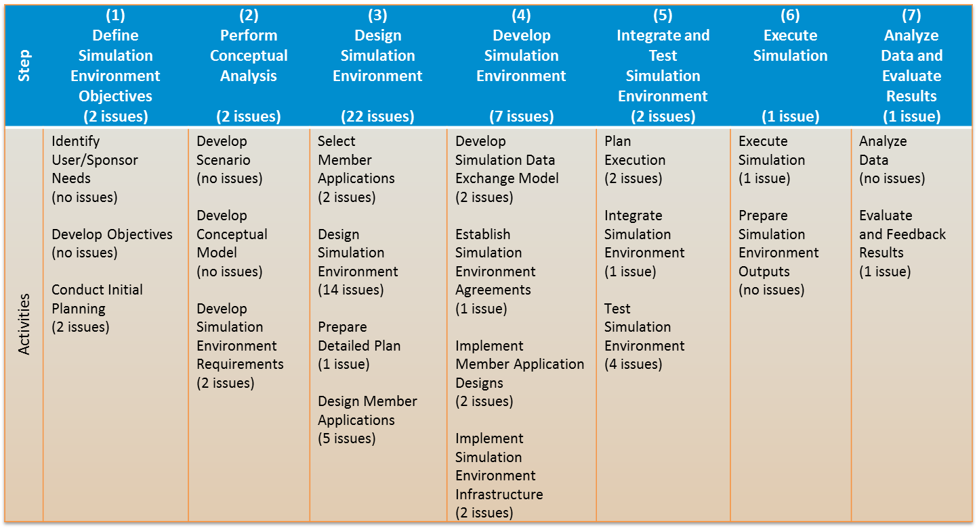
DMAO Overview
LVC environments are mixed architecture environments.
DMAO extends the DSEEP by identifying issues unique to LVC development and defining best practices for addressing those issues.
It’s unlikely that a single mixed-architecture environment will have all of these issues, but all mixed-architecture environments will have some of them.
Notes:
As stated on slide 6, the DMAO is an overlay to the DSEEP focusing on the issues unique to multi-architecture environments. Within each activity of the DSEEP, multi-architecture specific issues are identified and solutions are proposed. The table on this slide identifies the number of issues per step and activity in the DSEEP. Note that the bulk of the issues are toward the middle of the systems engineering process, e.g. design simulation environment and develop simulation environment. This makes sense because these are the steps of the process that focus most on the LVC architecture. LVC environments are inherently mixed architecture environments which is why the DMAO is so important to this class. While it’s unlikely that a single mixed architecture environment will have all of the issues identified in the DMAO, all mixed-architecture environments will have some of them.

Slide 11
FEAT Overview
  All LVC implementations need to establish federation agreements.
  Prior to the standardization of FEAT, there was no standard/convention for their structure or content.
    Reducing the opportunity for reuse
    Impeding comprehension by new federation participants.
  FEAT also serves as a checklist for identifying agreements that should be made and recorded.
Just as the 5-paragraph order is a template to communicate a leader’s military plans, the FEAT is a template that will document and communicate LVC federation engineering decisions.
Notes:
The third standard that will be applied in this class is the FEAT. All LVC implementations need to establish federation agreements. Prior to the standardization of FEAT there was no standard or convention for the structure and content of such agreements. This gap reduced the opportunity for reuse of agreements and impeded comprehension of existing agreements by new federation participants. Recall the training goal to reduce unnecessary operational and technical risks. The FEAT also serves as a checklist for identifying agreements that should be made and recorded. It is often the case that federation development teams implicitly make agreements, but don’t consider the need to record them. This failure leads to confusion and misunderstanding which introduce errors. Comparing the FEAT as a template to the five paragraph order for communicating a leader’s military plan, the FEAT is a template to document and communicate LVC federation engineering decisions.

Slide 12
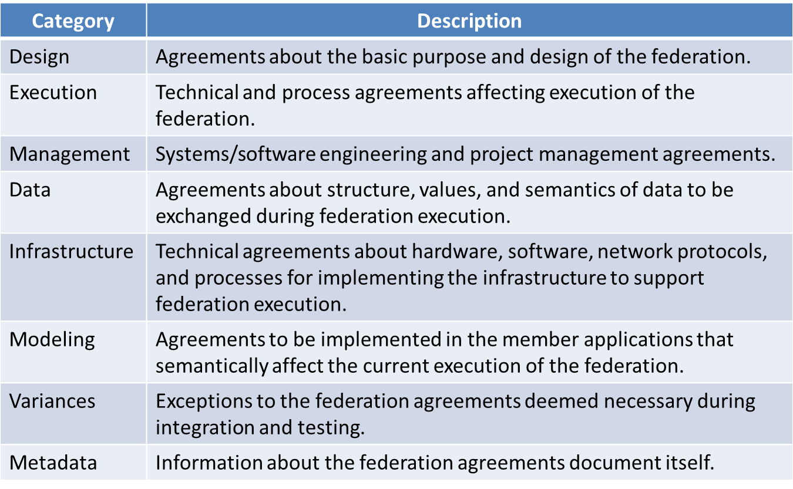
FEAT’s “8-Paragraph” Categories
Notes:
Here are the eight categories of federation agreements.
Design agreements focus on the basic purpose and design of the federation. This includes objectives, requirements, and scenario.
Execution agreements are technical and process agreements affecting execution of the federation such as monitoring and data logging.
The management agreements focus on systems and software engineering, and project management agreements. This includes processes such as configuration management.
Data agreements are about the structure, values, and semantics of data to exchange during federation execution including runtime data and initialization databases.
Infrastructure agreements are about hardware software, network protocols, and processes for implementing the infrastructure to support federation execution.
Agreements to be implemented in the member applications that semantically affect the current execution of the federation are recorded in modeling agreements. These agreements focus on model semantics and phenomena.
The purpose of variances is to record exceptions to the federation engineering agreements that are deemed necessary during integration and testing. Because many federations are reused multiple times, variances are important for improving the process the next time the federation is used. federation engineering for such reuse should review and evaluate variances to determine errors or shortcomings in the federation engineering agreements previously made and recorded.
Finally, the metadata provides information about the federation agreements document itself such as title, version number, etc.

Slide 13
LVC Definitions
Live - Simulation involving real people operating real systems. Military training events using real equipment are live simulations. They are considered simulations because they are not conducted against a live enemy.
Virtual - Simulation involving real people operating simulated systems. Virtual simulations inject human-in-the-loop in a central role by exercising motor control skills, e.g. flying an airplane and decision skills, e.g. committing fire control resources to action.
Constructive - Models that involve simulated people operating simulated systems. Real people stimulate (make inputs) to such simulations, but are not involved in determining the outcomes, e.g. semi-automated force (SAF) simulations.
Notes:
Before proceeding to the individual federation engineering issues, clear definitions of LVC are necessary.
Live simulation involves real people operating real systems. Military training events, for example, using instrumented, real equipment are live simulations. These are considered simulations because they’re not conducted against a live enemy and do not include the use of live weapons.
Virtual simulations involve real people operating simulated systems. Flight or tank simulators are good examples of virtual simulations. Virtual simulations inject the human in the loop in a central role by exercising motor control skills and decision skills.
Constructive simulations involve simulated people operating simulated systems. Real people stimulate such simulations, but are not involved in determining the outcomes nor controlling individual entities. Semi-automated force (SAF) simulations are good examples of constructive simulations.

Slide 14
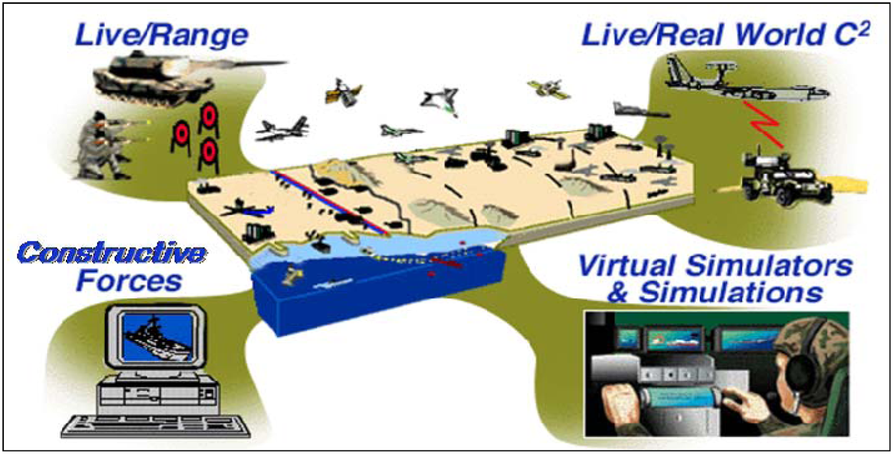
Distributed LVC Environments
Notes:
This slide provides a logical view of an LVC environment at the highest level. For example, a tank driving on a live range may be instrumented to interact with the LVC environment through a satellite link. Live mission command systems can exchange data with the LVC environment through gateways that convert their message protocols to simulation protocols. At the same time, live players in simulators, such as the tank simulator shown here, may interact with the live player and with the constructive SAF shown at the bottom left. All of these simulations and simulators interact with each other through some integrating simulation architecture.

Slide 15
Requirements for LVC Environments
The systems engineering process for LVC environments must begin with a clear operational requirement that is deconstructed into functional requirements which will set the criteria for technical requirements.
  For example, a training and readiness event is deconstructed into several tasks and conditions that must be performed to a specific standard.
Operational requirements are typically documented in DoD terminology that is unambiguous to the DoD audience.
Technical requirements are typically documented in engineering terminology that is unambiguous to developers.
Functional requirements ensure the bridging of the two.
Operational Requirement: The DoD relevant event that the LVC capability is targeted to simulate.
  Used to make accreditation determinations.
Functional Requirement: The tasks and conditions that the LVC capability must simulate to meet the operational requirement intent.
  Used to make validation determinations.
Technical Requirement: The software and hardware specifications that are required to be implemented to simulate the functional requirements.
  Used to make verification determinations
Notes:
Before we moved to LVC federation engineering issues, it’s important to understand what the requirements are for LVC environments. We address three types of requirements: operational requirements are for DoD-relevant events that the LVC capability is targeted to simulate. A functional requirement is the task or condition that the LVC capability must simulate to meet the operational requirement’s intent. In the remainder of this class, we will focus on technical requirements. These requirements are for the software and hardware specifications that are required to be implemented to simulate the functional requirements.
Using these definitions, the systems engineering process for LVC environments begins with the operational requirement. The operational requirement is then deconstructed into functional requirements which will in turn set the criteria for technical requirements. The key to producing sound, testable requirements is to ensure clear traceability between the three levels of requirements. While the operational requirements are typically documented in DoD terminology that is unambiguous to the DoD audience, technical requirements are typically documented in engineering terminology that is unambiguous to developers. So, the key to good requirements traceability lies in the functional requirements that bridge operational and technical requirements.

Slide 16
LVC Federation Engineering Issues
Each issue is presented on a single slide using this template.
Each slide will include a brief description of the issue.
Definitions will be provided for terms.
A bumper sticker will alert the student to the risk of not addressing the issue.
A reference block will direct the student to sections in the DSEEP, DMAO, and FEAT that describe the issue and potential solutions in detail.
DSEEP | DMAO | FEAT
Notes:
This slide is a template for each of the LVC federation engineering issues addressed in this class. Each issue is presented on a single slide using this template. Each slide includes a brief description of the issue on the left side. The right-hand column provides definitions for terms with which the student may be unfamiliar. The lower right corner of each slide contains a bumper sticker that alerts the student to the risk of not addressing the issue. Finally, the very right lower corner of each slide contains a three-color table. This table provides references for further research and reading by the student. It includes references to the appropriate sections of the DSEEP, DMAO, and FEAT.

Slide 17
Data Exchange Model (DEM)
For an LVC environment to operate properly, applications must exchange data at runtime.
Different LVC architectures format data using different structures, e.g.
  Distributed Interactive Simulation (DIS) Protocol Data Units (PDUs)
  High Level Architecture (HLA) interactions and object class attribute updates
The format may also differ between versions of a single standard.
Applications may represent the same type of data differently, e.g.
  Coordinate systems
  Direction and speed
DEM - A specification defining the information exchanged at runtime to achieve a given set of simulation objectives.
  This includes class relationships, data structures, parameters, and other relevant information.
Simulations with mismatched DEMs cannot communicate.
DSEEP | DMAO | FEAT
4.4.1 | 4.4.1.1.2 | Data/DataExchangeModels
Notes:
The first federation engineering issue is the data exchange model (DEM). For an LVC environment to operate properly, applications must exchange data at runtime. Data exchange is the primary purpose of any LVC architecture. However, different LVC architectures format data using different structures. For example, DIS uses PDUs while HLA uses interactions and object class attribute updates. Not only does this format differ between standards / architectures, but it may also differ between versions of a single standard. Additionally, applications may represent the same type of data differently such as coordinate systems, and direction and speed. If applications represent the same type of data differently internally, some conversion must be made somewhere in the architecture to share that data with other applications. Simulations with mismatched DEMs cannot communicate. Since data exchange is the primary purpose of an LVC architecture, DEM incompatibility is one of the greatest risks to LVC environment interoperability.

Slide 18
Data Storage Formats
Input databases that represent the same type of phenomena may be in very different formats.
  Terrain
  Order of battle / laydown
Accurate, lossless conversion between formats may not be technically feasible.
Conversion can be expensive and time consuming.
Lossless - without loss of precision or accuracy; conversion of a datum from one format to another and back again produces the original value.
Data conversion will negatively impact cost and schedule.
DSEEP | DMAO | FEAT
N/A | N/A | Data/supportingDatabases
Notes:
There are many data storage formats for some types of logically similar data, for example terrain or order of battle. If different simulations in a federation need to use the same database to initialize, but they require different data storage formats, the database must be converted to their individual formats. Accurate, lossless conversion between these formats may not be technically feasible. And where is technically feasible, conversion can be expensive and time-consuming, almost certainly negatively impacting cost and schedule.

Slide 19
Protocol / Architecture / Middleware
There can be incompatibilities at every level of protocol/architecture/middleware.
  Different architecture / protocols
    HLA vs. DIS vs. Test and Training Enabling Architecture (TENA)
  Different versions of the same architecture / protocol
    DIS v6 vs. v7
    DoD HLA 1.3 vs. Institute for Electrical and Electronics Engineering (IEEE) 1516-2000 vs. IEEE 1516-2010 vs. HLA “Run-time Infrastructures” (RTIs) not completely compliant with any authoritative standard
  Different implementations (middleware) of the same version of a standard
    IEEE 1516-2010 RTIs from different vendors
Communicating between these requires some form of gateway.
Middleware - Software that connects or integrates other software modules or components, typically providing a set of communications or interaction functions that may be invoked by the linked modules.
Gateway - A device that connects two systems, especially if the systems use different protocols.
Inserting gateways to overcome incompatibilities introduces cost and latency, and potentially impacts schedule.
DSEEP | DMAO | FEAT
N/A | N/A | Infrastructure/middleware
Notes:
One of the first incompatibilities encountered in LVC federation engineering is incompatibility of protocol, architecture, or middleware. Middleware is the software that connects or integrates other software modules or components, typically providing a set of communications or interaction functions that may be invoked by linked simulations. From another perspective, middleware is often used to implement a protocol or architecture. It’s the software responsible for exchanging the data whose format is defined by the DEM. Not only are there multiple different architectures and protocols such as HLA, DIS, and TENA, but there are also different versions of the same architecture and protocol. For example, DIS version 6 versus version 7. There are three versions of the HLA standard, one DoD standard and two versions of the IEEE standard. Furthermore, even if the same version of the same standard is used, different implementations of middleware may be incompatible. Addressing these incompatibilities requires communicating between these architectures with a gateway. A gateway is a device that connects two systems especially, systems using different protocols. Because a gateway is a physical device running software, inserting one into your architecture to overcome incompatibilities introduces cost and latency communicating across the architecture. The process of buying, building, configuring, and integrating the gateway can also negatively impact schedule.

Slide 20
Latency
If applications or architectures run in real time, latency may introduce causal (fair fight) anomalies between applications.
  An third-party observer application may observe the effects of a munitions fire before observing the munitions fire if there is less latency between the observer and the target than the observer and the shooter.
Latency can be exacerbated by the use of gateways that translate between architectures:
  Latency for the time required to translate the data from one protocol to another
  Latency for an additional network message transmission if the gateway(s) are separate network nodes
  Each additional gateway introduces additional latency.
Latency – time delay between any two simulations, from submitting a message from the sending simulation to receiving this message by the recipient simulation.
Fair fight - differences in simulations' performance characteristics have significantly less effect on the outcome of the conflict than actions taken by the simulations.
Latency can introduce fair fight anomalies.
DSEEP | DMAO | FEAT
N/A | 4.3.2.1.1 | N/A
Notes:
Latency is the time delay between any two simulators or simulations from the time a message is sent to the time it is received. All LVC environments have some amount of latency because they are networked. The LVC federation engineering challenge is to ensure that latency is low enough to meet the technical requirements. Latency constraints are typically the most strict for real-time applications such as training. The primary risk of latency is that it can introduce fair fight anomalies, where fair fight is the difference in the performance of two simulations that impacts the outcome of their interaction. A common example of a latency-induced causality anomaly is when a third-party observer application may observe the effects of a munitions fire before observing the munitions fire. This can occur if there is less latency between the observer and the target than there is between the observer and the shooter. As previously described, latency can be exacerbated by the use of gateways to translate between architectures.

Slide 21
Interest Management
Interest management approaches vary widely by architecture.
Approaches include filtering by:
  Message class
  Message content
  Geographic region
  Site / Host identification
  Functions external to message content or class
These approaches can be very different semantically and functionally.
Where translation between approaches is technically feasible, it usually requires a gateway.
Interest management decisions are based on the simulation domain and scenario.
  Ensure that too much data isn’t filtered out because failure to receive some data can cause semantic / fair fight issues.
Interest management – data filtering capabilities designed to limit network data transmissions so applications receive only the data in which they are interested .
Required data may be filtered out before it reaches a simulation, resulting in inconsistent state between simulations.
DSEEP | DMAO | FEAT
N/A | 4.3.2.1.5 | Modeling/ddm
Notes:
While it is the purpose of LVC architectures to transmit data between simulations, it is often the case that the architecture can transmit too much data for simulations to process and consume. Many LVC architectures implement some form of interest management, a form of data filtering designed to limit network data transmissions so simulations only receive the data in which they’re interested. These interest management approaches vary widely by architecture. These approaches may include filtering by message class, message content, geographic region, site or host identification, or functions external to message content or class. As evidenced by this list, these approaches can be very different semantically and functionally. In many cases, translation between these approaches is not technically feasible. Where it is feasible, it usually requires a gateway which introduces latency. The decision on how to apply interest management is based on simulation domain and scenario. The challenge is to achieve an effective balance in filtering. Too little filtering results in simulations being overwhelmed by irrelevant data. Too much filtering can result in simulations not receiving data they require to function semantically correctly. In this latter case, the result will be inconsistent state between simulations and possibly fair fight issues.

Slide 22
Time Management
Applications may or may not have the ability to control the rate at which they advance time and / or order events.
  Mission command (MC) systems usually do not operate accurately with any rate other than real-time.
Time advancement strategies differ.
  Scaled as a factor of wall clock time
    Real-time is a special case of scaled where the scale is 1-1.
  Discrete event, i.e. controlled by message time stamps
    This can be faster or slower than real-time.
    Mechanisms exist for rewinding to an earlier time, but are complex and infrequently used.
  Synchronization points defined at scenario-specific events, e.g. once initial scenario generation is completed by all simulations
  See [5, 6] for a discussion of how different time advancements strategies may and may not interoperate.
  See [6] for a discussion of the consequences of causality failure in real-time simulations.
The format and mechanism for sharing time advances between applications may differ by architecture.
Time management – maintaining a common sense of time among all federates (applications), either based on real time clock or based on an event based clock.
Real-time - Simulated time advances at the same rate as actual time (wall clock time.
Mismatched time management strategies can introduce causality (fair fight) errors.
DSEEP | DMAO | FEAT
4.2.3.2 | 4.3.2.1.4 | Execution/timeManagement
Notes:
Time management is the process of maintaining a common sense of time among all simulations. Time can be based on a real time (wall clock time) or an event-based clock. Some applications in an LVC environment may not be able to control the rate at which they advance time and / or order of events. For example, mission command systems usually do not operate accurately with any rate other than real time. There are many different time advancements strategies. Time management is a complex topic; the student is referred to references five and six for information on different time advancement strategies, their interoperability, and the consequences of causality failure. The key take away from this issue is that the format and mechanism for sharing time advances may differ by architecture. As has been described under other federation engineering topics, one of the risks of failure to address time management is causality or fair fight errors.

Slide 23
Heartbeat Translation
DIS requires Entity State PDUs be sent for all entities at a standard-specified minimum frequency, even if the entities are completely static.
  The standard value for HRT_BEAT_TIMER is 5 seconds.
This can create unnecessary message traffic and overhead in non-DIS applications that send object updates only when an attribute value has changed.
Heartbeat – a periodic entity state update message used by DIS.
Timeout – The period of real-world time after which the data associated with a PDU type for a specific object is cleared from a receiving simulation’s database if no new PDU is received.
Failure to generate heartbeats by non-DIS applications can cause unintended entity deletion in DIS applications as a result of timeout.
DSEEP | DMAO | FEAT
N/A | 4.3.2.1.7 | N/A
Notes:
The DIS standard uses heartbeats, periodic entity state update messages, to inform simulations that entities are still “alive.” There is a timeout period after which the entity is assumed to be “dead” or removed from the federation. This is true even if the entity is completely static. If a DIS simulation is integrated with other non-DIS applications, these heartbeats can create unnecessary message traffic. Conversely, failure to generate heartbeats by non-DIS applications can cause unintended entity deletions in the DIS applications. The result can be semantic anomalies or fair fight issues.

Slide 24
Save and Restore
While some architectures provide the hooks for initiating save and restore of applications, individual applications are usually responsible for saving and restoring their own state.
  HLA has Initiate Federate Save and Initiate Federate Restore
Save and restore signals must be coordinated across architectures, possibly through gateways.
Saving the state of individual applications must be synchronized to ensure that the federation can be restored to a consistent state for a specified point in time.
-- No definitions --
Individual simulations may not restore or may restore to a state inconsistent with the rest of the federation.
DSEEP | DMAO | FEAT
4.4.2 | 4.3.2.1.12 | Execution/executionStates
Notes:
Federations are often saved in order to ensure that they can be restored consistently in the event of a failure. While some architectures provide the hooks for initiating save and restore of individual simulations, the simulations themselves are usually responsible for saving and restoring their own state. For example, HLA has two services, Initiate Federate Save and Initiate Federate Restore, to signal federates to perform these activities. Like other functionality previously reviewed, the implementation of these functions varies across protocols and architectures. So save and restore signals must be coordinated across architectures, possibly through gateways. Saving the state of individual applications must be synchronized to ensure that the federation can be restored to a consistent state at a specified point in time. If the restored state is not consistent with the state of the federation at the time it was saved, the federation may need to be restarted from the beginning, resulting in significant negative impacts to cost, schedule, and achievement of mission objectives.

Slide 25
Initialization Sequencing and Synchronization
Some applications have explicit or implicit requirements for initialization ordering.
  They assume actions will be taken by other applications in the federation before they can proceed.
  HLA requires that federates explicitly “join” a federation to enable federation management [see Monitoring and Control].
Gateways or middleware linking multiple architectures may exacerbate this issue.
Federations that connect to operational systems or instrumentation may need those systems or instrumentation to be switched on prior to initialization.
Sequencing constraints may be difficult to enforce automatically.
-- No definitions --
Failure to synchronize may prevent some simulations from entering the federation or to enter in an inconsistent state.
DSEEP | DMAO | FEAT
4.4.2 | 4.4.2.1.3 | Execution/executionStates
Notes:
Some applications and federations have explicit or implicit requirements for initialization order. They may assume that actions will be taken by other applications in the federation before they can proceed. For example, HLA requires that federates explicitly join the federation to enable federation management. Gateways or middleware linking multiple architectures may exacerbate this issue. Federations that connect to operational systems or instrumentation may need those systems to be switched on prior to federation initialization because those systems may not be externally controllable. This is an example where sequencing constraints may be difficult to enforce automatically. The failure to synchronize may prevent other simulations from entering the federation or they may enter in an inconsistent state, requiring re-initialization of the federation.

Slide 26
Incompatible Algorithmic Models
Physical phenomena may be modeled in simulations using different and incompatible algorithms, e.g.
  Dead reckoning
  Aggregation
  Effects adjudication
If simulations logically engaged in modeling the same phenomenon use incompatible algorithms, their results can vary.
  Potentially, this can impact the federation’s validity, particularly fair fight.
Aggregation – ability to group entities while preserving the collective effects of entity behavior and interaction while grouped.
Dead reckoning - simulations maintain a simplified representation of the positions of nearby entities and extrapolate their last reported positions until the next state update information arrives.
Effects adjudication – estimating the effects of individual simulations' actions on other simulations.
Incompatible models can introduce inconsistent and invalid simulation states.
DSEEP | DMAO | FEAT
4.2.2, 4.4.2 | 4.4.3.1.1 | Modeling/deadReckoning, Modeling/effectsAdjudication, Modeling/aggregation
Notes:
Physical phenomena modeled inside simulations may use different or incompatible algorithms to represent the same phenomenon. Examples of this include dead reckoning, aggregation, and affects adjudication, among others. If simulations in a federation are logically engaged in modeling the same phenomenon using incompatible algorithms, the results can vary. This can impact the federations validity, particularly fair fight. In general, incompatible models introduce inconsistent and invalid simulation states.

Slide 27
Network Configuration
Incompatibilities may be introduced by network protocol configuration options preferred by different simulation architectures including varying data formats.
  DIS prefers User Datagram Protocol (UDP).
  HLA RTIs may require multicast.
    Multicast is not a standard setting for DoD routers.
This may require conversion of data formats to the most efficient protocol.
  Which in turn may require introducing gateways with attendant cost, schedule, and technical risk.
User Datagram Protocol – a connectionless, best effort, "unreliable" protocol.
Multicast - one-to-many or many-to-many distribution group communication where information is addressed to a group of destination computers simultaneously.
Incompatible network configurations may prevent simulations from communicating.
DSEEP | DMAO | FEAT
4.4.4 | 4.4.4.1.1 | Infrastructure/networking, Infrastructure/secondaryCommChannels
Notes:
As previously discussed, the primary purpose of LVC environments is to exchange data between simulations. This data exchange requires the use of network protocols. Different simulation architectures may use different network protocols or different configuration options. For example, DIS prefers user datagram protocol (UDP), a connectionless, best effort, "unreliable" protocol. Many HLA RTI’s require multicast; multicast is not a standard setting for DoD routers. As with so many issues already reviewed, conversion between incompatibilities may require the introduction of gateways with their attendant cost, schedule, and technical risks. The bottom line is that incompatible network configurations can prevent simulations from communicating at all.

Slide 28
Monitoring and Control
Monitoring
  Confirm that applications continue to execute as expected
  Observe the status and disposition of simulated entities
Control
  Explicitly directing applications to perform management operations:
    Initializing
    Pausing / resuming
    Joining and leaving the simulation
  Some simulations also have the hooks to have individual entities controlled externally, e.g. moving their position.
Without hooks and applications for monitoring and control of the simulation environment, a single simulation application can hang or crash the entire environment.
  The HLA has the Management Object Model (MOM) that provides the hooks into the RTI to monitor and control a federation.
-- No definitions --
A single simulation can hang or crash a federation without monitoring and control.
DSEEP | DMAO | FEAT
4.2.3, 4.6.1 | 4.6.1.1.1 | Execution/monitoring, Execution/executionStates, Execution/joinAndResign
Notes:
Because LVC environments typically involve many applications at multiple locations, their correct execution requires monitoring and control. Among other things, monitoring includes confirming that applications continue to execute as expected, and observing the status and disposition of simulated entities. Monitoring is passive while control is active. Control can include explicitly directing applications to perform management operations. Some simulations also have hooks to allow individual entities to be controlled externally such as moving the position of these entities. Without hooks and applications for monitoring and control of the LVC environment, individual simulation applications can hang or crash the entire environment.

Slide 29
Data Collection
Data for analysis and after action review (AAR) may be collected in multiple locations in a simulation architecture.
  Data collected at multiple locations must be collected, combined, correlated, and ordered to produce a coherent and consistent picture of the execution.
Different definitions, formats, and resolutions for location (TSPI or PLI) exacerbate this process because it’s used to correlate records for individual entity collected from different locations in the simulation architecture.
  If position data for an individual entity is collected at multiple locations in the architecture, a decision must be made about which location is authoritative.
Data collection tools may be specific to a single architecture.
TSPI – Time-Space-Position Information.
PLI – Position Location Information.
Inconsistent or incomplete data collection can make accurate AAR difficult or impossible.
DSEEP | DMAO | FEAT
4.2.3.2, 4.5.3 | 4.6.1.1.2 | Execution/dataLogging
Notes:
The determination of the validity and efficacy of a federation execution almost always requires data analysis and after action review (AAR). Because LVC environments are distributed across multiple locations, data is collected at multiple physical locations. This data must be collected, combined, correlated, and ordered to produce a coherent and consistent picture of the execution. Correlation and analysis may be complicated by the fact that data collection tools may be specific to a single architecture with different data storage formats. Additionally, there are different definitions, formats, and resolutions for location information. Because location information is used to correlate records for individual entities, different simulations using different location specifications may produce inconsistent reports about the same logical entity. This makes the task of correlating and analyzing the data challenging.

Slide 30
Network Security / Information Assurance
Operating in a secure environment require:
  Cross domain solution(s) (CDSs), e.g. Radiant Mercury, for multi-level security.
  Permission to connect and operate.
Cross domain solutions are typically expensive to purchase, configure, and accredit.
  They must be accredited for every configuration / environment in which they’re used.
Permission to connect and operate is absolute; there are no workarounds.
  Determine security requirements and POCs as early as possible.
  Maintain documentation of all communications and tasks performed.
Multi-level security – use of an IT system to process information at different security classification levels.
Cross domain solution – a hardware / software capability to manually or automatically access or transfer information between two or more differing security domains; a solution to one type of multi-level security problem.
Federations and simulations that fail IA requirements will not be allowed to operate.
DSEEP | DMAO | FEAT
4.3.4 | 4.4.4.1.1 | Infrastructure/networking
Notes:
It is increasingly the case that many LVC environments are classified. All LVC environments require some amount of network security and information assurance. In all these environments, permission to connect and operate is absolute; there are no workarounds. This means that determining security requirements and points of contact for security/IA is paramount. Operating in a secure environment may require cross domain solutions in addition to permission to connect and operate. These cross domain solutions are typically expensive to purchase, configure, and accredit. And they must be accredited for every configuration or environment in which they are used. It is not possible to overstate the importance of identifying security/IA requirements early, and working through them consistently and in a timely matter.

Slide 31
Ground Truth
Data sent on the network describing the state of entities may not be “ground truth,” i.e., it may not correctly reflect the true state of simulated entities.
Individual simulations may intentionally degrade or corrupt that ground truth information in situations where a system or entity they are simulating would not have access to perfect and complete information.
  The exact location of an aircraft whose performance specifications are classified may be “fuzzed.”
Simulations and control applications need to have a clear understanding of which data is ground truth and which isn’t.
  See Data Collection and Terrain.
Ground truth – the actual facts of a situation, without errors introduced by sensors or human perception and judgment; the actual state of a simulated entity.
Misinterpreting which data is ground truth can introduce inconsistent simulation states.
DSEEP | DMAO | FEAT
N/A | 4.3.2.1.9 | N/A
Notes:
Ground truth represents the actual facts of the situation without errors introduced by sensors of human perception and judgment. In a simulation, this is the actual state of the simulated entities. Conversely, data sent on the network describing the state of entities may not be ground truth; it may not correctly reflect the true state of simulated entities. This may be the case because individual simulations may intentionally degrade or corrupt ground truth information in situations where the systems or entities they are simulating would not have access to perfect and complete information. For example, the exact location of an aircraft whose performance specifications are classified may be “fuzzed.” Simulations and control applications need to have a clear understanding of which data is ground truth and which isn’t. This determination can impact other issues such as data collection and terrain.

Slide 32
Ownership Transfer
The ability to transfer ownership of entity attributes among simulations is required to support the cooperative modeling of a given object instance across a federation, e.g.
  In a WAN environment, ownership of a fast-moving aircraft may be transferred to a simulation that is interacting with the aircraft to ensure network latency doesn’t impact fair fight.
Different architectures / protocols implement ownership transfer differently.
Where translation between approaches is technically feasible, it usually requires a gateway.
  As previously discussed, gateways introduce latency.
Ownership - the authority to simulate, modify, and delete the attributes of a simulated entity.
Incompatible implementations of ownership transfer can result in simulated entities being orphaned or multiple, inconsistent versions being modeled.
DSEEP | DMAO | FEAT
N/A | 4.2.3.1.2, 4.3.2.1.3 | Modeling/controlTransfers
Notes:
Although it is rarely used, many simulation architectures have the ability to transfer ownership of entities’ attributes between simulations. This functionality is required to support the cooperative modeling of some entities across the federation. For example, in a WAN environment, ownership of a fast-moving aircraft may be transferred to a simulation that is interacting with the aircraft to ensure network latency doesn’t impact fair fight. Like so many other functions, ownership is implemented differently in different architectures and protocols. Where translation between approaches is technically feasible, it usually requires a gateway which introduces latency. Incompatible implementations of ownership transfer can result in simulated entities being orphaned, i.e. unintentionally dropped from the federation, or multiple simulations modeling the same entity inconsistently.

Slide 33
Terrain
Different simulation communities and simulation products use different representations of terrain, e.g.
  Synthetic Environment Data Representation and Interchange Specification (SEDRIS).
  OpenFlight
  Digital Terrain Elevation Data (DTED).
Correlation of entity location between simulations using different representations is a common problem because lossless translation between the representations is often not possible.
  Sometimes leading to errors like floating tanks.
Terrain - the vertical and horizontal dimension of land surface; in simulation it can also encompass other aspects of the physical environment including soil properties, vegetation, and human-made structures.
Intervisibility - the relative ability to be seen under given conditions of distance, light, atmosphere, etc.:
Simulated entity locations can be physically impossible or terrain-dependent phenomena, e.g. intervisibility, can be inconsistent.
DSEEP | DMAO | FEAT
4.2.1 | 4.2.1 | Design/terrain
Notes:
This slide lists just a few of the different terrain representation formats used by different simulation communities and products. Correlation of entity location between simulations using different representations is a common problem because lossless translation between the representations is often not possible. As a result, some simulated entity locations can be physically impossible such as floating tanks. Inconsistent terrain representations can also impact terrain-dependent phenomena such as inter-visibility, causing inconsistencies between simulations and fair fight issues.

Slide 34
References
IEEE Std 1730-2010, Distributed Simulation Engineering and Execution Process (DSEEP)
IEEE Std 1730.1-2013, Distributed Simulation Engineering and Execution Process (DSEEP) Multi-Architecture Overlay (DMAO)
SISO-STD-012-2013, Federation Engineering Agreements Template (FEAT)
DoD M&S Glossary
IEEE Std 1516.1-2010, Modeling and Simulation (M&S) High Level Architecture (HLA) – Federate Interface Specification
Richard Fujimoto, Parallel and Distributed Simulation Systems, 2000
IEEE Std 1278.1-2012, Distributed Interactive Simulation – Application Protocols

