Slide 1
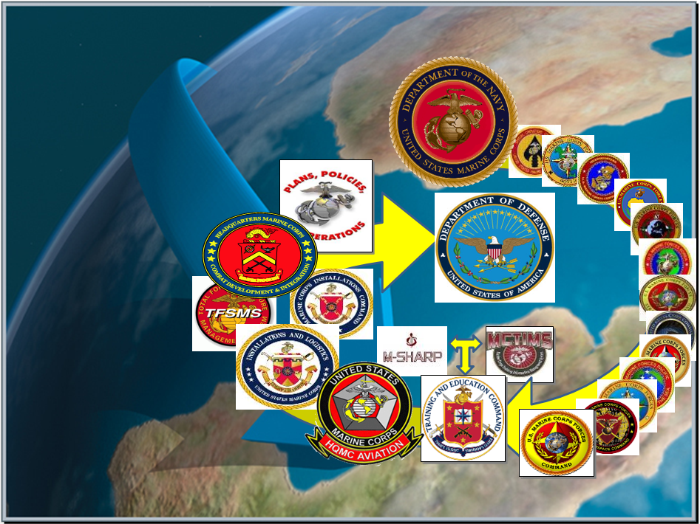
Marine Corps Task List
Mission Essential Task List
MCTL / MET / METL
Life Cycle Development
MAR 2023
MCTL Branch
Marine Corps Integration Division-Plans
HQMC, CD&I, CDD

Slide 2
Overview
MCTL Branch Mission = Life Cycle “Data Driven” Deliverables
Integrated Planning-to-Capabilities-to-Readiness
CD&I’s Process/Policy Alignments = Workshop “Data Driven” Deliverables
MCTL: The Dictionary of Current Capabilities, MET Building Blocks, New/Revised MCTs
MCT / MET Review Process: Intent, Coordination, Validation, Adaptation, Integration
MCTL/MET/METL Development Process Supports Force Design 2030
Review Workshop Goals: MET “Baseline/Advanced” Capability Statements, Deliverables, Staffing, Approvals and DRRS Assessments
TFSMS / MCTIMS / MSHARP: Authoritative Data Source Systems detailing Current MAGTF Capabilities
CD&I METL Governance Board and Quarterly Checklist
CD&I’s Role in Force Development, GFM, Readiness Synch, MET Alignments-DRRS, IRWG/QRB and PPBE
MCTL/MET/METL Life Cycle Products Info: HQMC CD&I MCTL Website; MCTIMS

Slide 3
CD&I / CDD / MCID-Plans
MCTL Branch Mission
DIRLAUTH per MCO 3500.26B (MCTL)
For development of defined content of capabilities/actions/activities expressed as Marine Corps Tasks (MCTs) resident within the Marine Corps Task List (MCTL) and Service Authoritative Database Source Systems MCTIMS and DRRS.
For ensuring MCTs are doctrine-based and developed products represent all elements of the MAGTF and SE.
DIRLAUTH per MCO 3500.110 (METL Development)
For FMF/SE MET/METL and standards development and review process.
Supports Future Force Design Capability Development, expressed as MCTs/“Future” METs
MCTL/MET/METL data represents “as-is” current Force capabilities
used to develop the “to-be” Future Force capabilities:
$${Capability=Tasks}^{ }+{ Conditions+ Standards+ Ways+ Means }^{ }$$
Derived from
UJTL “Conditions” list ISO OPLAN/Assigned Mission, or Wargame Scenario
Measures from
UJTL/MCTL, with criteria and scale to produce specific outputs
Doctrine
Tactics
T&R Manual
Procedures
Processes
Performers Resources
(T/O&E)
Capability Achieves Desired Effect(s)
Fully Described (Instantiated)
MCT
MET

Slide 4

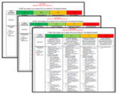





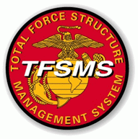

MCT / MET / METL Integrated Life Cycle
CURRENT Force Capability Requirements: Core/OPLAN/Assigned Mission
FUTURE Capabilities: Future Force Design
Current Deployable and Ready Mission Forces METs/METLs
USMC READINESS
DRRS Enterprise
MCTL “Tasks” = METs / METLs (MCTIMS)
Structure = Mission Statement/T/O&E (TFSMS)
Training = T&R Manual (MCTIMS)
Baseline/Advanced Performance Standards
Man / Train / Equip / Output
USMC MISSION
(Current-to-Future
Future-to-Current
Cycle)
REQUIREMENTS
CAPABILITIES
STRUCTURE / RESOURCES
RFFs / RFCs - FORCE SOURCING ESTABLISHED USMC CURRENT CAPABILITIES
MISSION READINESS ASSESSMENTS
“Force in Readiness”
Mission Planning + Requirements + Capabilities + Resources =
Sourcing the Force and Reporting FMF Readiness in DRRS

Slide 5

CD&I’s Policy Alignments:
MCTL (MCO 3500.26) and MET / METL Development (MCO 3500.110)
Total Force Structure Process (MCO 5311.1E)
MET/METL Development: Supports mission planning, training and T&R Manual review and development processes. Coordinated process involving CD&I, Stakeholder, PP&O and TECOM.
Aligns to…
Mission Statement & T/O&E Validation: MCID/Future OPS TFS process where Unit/COI defined organizational capability and mission intent is expressed within TFSMS. MET/METL alignment aids in personnel standards and required equipment development.
Aligns to…
TECOM’s T&R Manual & TMT Reviews: TECOM training processes that identifies MET-based training component requirements, necessary event chaining and exercise synchronizations, POI and curriculum refinement and development.
Supports…
PP&O’s GFM Processes and FMF / SE Readiness Reporting Requirements
Plans, Policies,
& Operations

Slide 6

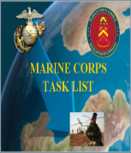
MCTL Supports Current Capability
MET/METL Development
MCTL: “Dictionary” of current USMC activities/actions/capabilities defined as “Tasks” that an organization must perform to accomplish a mission.
  MCT’s are used by COI / SE as “Building Blocks” for METs/METLs
MCTs are Organized by the Six (6) Warfighting Functions (WFF):
  Maneuver
  Intelligence
  Fires
  Logistics
  Command and Control
  Force Protection
Contains Task Title, Task Definition, Doctrinal Ref and Suggested Measures of Performance
USMC TASKS:
MCT 1.6.1 Conduct Offensive Ops
MCT 1.6.4 Conduct Defensive Ops
MCT 1.10 Conduct Crisis Response
MCT 1.12 Conduct Expeditionary Ops
MCT 1.13.2 Conduct NEO
MCT 1.15.1.2 Facilitate Foreign HA
1. MCT 1.6.1 Conduct Offensive Ops
MCT 1.6.4 Conduct Defensive Ops
MCT 1.10 Conduct Crisis Response
MCT 1.12 Conduct Expeditionary Ops
MCT 1.13.2 Conduct NEO**
MCT 1.15.1.2 Facilitate Foreign HA**
**Not deemed CORE by Community but could be CORE+ for Assigned Mission / OPLAN METL
Official Tri-Service Directive
OPNAVINST 3500.38C
MCO 3500.26B
USCG COMDTINST 3500.1C
Revised 16 Aug 2018
EX: INFANTRY CORE METL
TASK (MET)
TASK (MET)
TASK (MET)
1
2
3
TASK (MET)
TASK (MET)
TASK (MET)
4
5
6
FMF/Units DRRS Report – 30 Day Interval
SE/Installations DRRS Report - Quarterly

Slide 7
NEW or Revised MCT Recommendations
REVISED MCT 3.2.3.1.2.1 Conduct Strike Strike operations damage or destroy an enemys objective or capability. Strike operations include both air interdiction and attack operations. Air interdiction is an air operation conducted to divert, disrupt, delay, or destroy the enemy’s military surface capabilities before it can be brought to bear effectively against friendly forces, or to otherwise achieve enemy objectives that are conducted at such distances from friendly forces that detailed integration of each air mission with the fire and movement of friendly forces is not required. Attack operations include offensive action by any part of the joint force in support of the Offensive Counterair (OCA) mission against targets which contribute to the enemys air and missile capabilities. JP 1, 0-2, 3-0, 3-01, 3-03, 3-09, 3-30, 3-31, MCWP 3-2, NDP 1, NWP 3 FORMER MCT TITLE/DEFINITION MCT 3.2.3.1.2.1 Conduct Air Interdiction Air interdiction operations destroy, neutralize, or delay the enemy's military potential. This type of operation is a response to a known target that is briefed in advance. Air interdiction is normally part of the JFC campaign.
A NEW/Revised MCT requires METL Review WG provide:
Described capability, actions, activities
Doctrinal support (USMC, Joint, Other Service)
Rationale of Task to meet HHQ guidance, mission statement and mission requirements
Coordination required to ensure Task is aligned to necessary training and T&R Manual alignments or modifications.
Crosswalked. Does the MCT revision potentially affect another COI that may be also using it as a MET for their DRRS report?
  MEU OAG
NEW
MCT 1.12.8 Establish and Operate Expeditionary Advanced Bases
To seize or occupy, establish, operate, sustain, and disestablish one or more expeditionary sites in support of naval operations, to include, but not limited to, ports, airfields, FARPs, forward operating bases, and firing areas. This task may include reducing pockets of resistance, establishing security, and operating the site(s) until the site is disestablished or control is transferred to another organization.
JP 3-0, 3-10.1, 3-18, MCDP 1-0, MCDP 3; MCWP 3-2, 3-32
  AVN METL Review Feb 2019

Slide 8

MET / METL Review Workshops Process
(MCO 3500.110**)
Policy oversight and integration between CD&I, TECOM, Stakeholder and FMF community to review/revise current, or develop new METs with identified man/train/equip and output standards satisfying mission requirements.
MSG (via NIPR DON-ETMS2/TMT / TEAMS invite) announces review requirements:
Mission Statement: Ensure organizational capability and mission intent can be met.
(Be prepared to submit recommendations for updating if needed.)
Marine Corps Tasks (MCTs): Do defined actions/activities/capabilities continue to satisfy the organizational mission intent and requirement?
(Be prepared to make MCT refinements/modifications if required.)
T/O&E: TFSMS personnel and equipment data aligned to METs/METL.
(*Identified discrepancies with T/O&E is facilitated through a separate process with oversight by CDD MCID-FOPS Total Force Structure Section)
T&R Manual: Determine training components/standards, training events.
(Be prepared to make recommendations for NEW training requirements.)
Record of Proceedings (ROP): Captures Rep attendance and recommendations:
  MCT changes facilitated by CD&I/CDD/MCID-Plans;
  T&R Manual refinements facilitated by TECOM
Plans, Policies,
& Operations
**2023-2024 MCO Revision: Modify 2011 MCO language to address changing roles/responsibilities, required METL development support, and evolving training and readiness reporting advancements

Slide 9
MET / METL Review Workshops Process
(MCO 3500.110)
MET / METL Review
DoD/JS Chairman’s Readiness – DRRS-Strategic
PP&O – DRRS-MC
A Unit’s Core METL
MET
MET
MET
MET
A NEW recommended MCT requires:
Title
Definition
Reference
Measures
MCT
Standard
Standard
Standard
MCT
Standard
Standard
Standard
MCT
Standard
Standard
Standard
Draft MCT
Standard
Standard
Standard
Identify Baseline / Advanced Capabilities
Capability Outputs / Manpower / Equipment
Training Events / Exercises
TECOM
MCTIMS Task Master
AO Staffing: (E-mail to Stakeholders and
Participants)
O-6 Staffing: (DON-Tracker)
GO Staffing: As Required
CD&I METL Governance Board

Slide 10
MET / METL Review Workshops Process
(MCO 3500.110)
Validation Elements
SUPPLIERS | INPUTS | PROCESS | OUTPUTS | CUSTOMERS
Units Installations | Unit w/Designed Capability Mission Statement SE and Installation Support to the Warfighter MCTL Task/s USMC or Joint Doctrine Conditions (Joint) T/O (MOS) & T/E (MEE/PEI) Training Events (E-Coded Individual/Collective) Exercises and CERTS aligned to COI T&R Manuals DoDI – Installation Benchmark and/or Title X Requirements | Process Flowchart Below Policy Controls: DoD DRRS Enterprise Policies MCO 3000.13 DRRS MCO 3500.26 (MCTL) MCO 5311.1E (TFSP) MCO 3500.110 (METL) MCO 1553.10 (MCTIMS) METL Development Workshops Stakeholder Adjudicate Incorporation into MCTL / MCTIMS / DRRS | List of “Mission Essential” MCTs Baseline/Advance Capability Statements per MET Standards/Criteria Metrics: - P = Personnel - E = Equipment - T = Training - O = Output | Commanders MARFORs/MEFs/ MEUs/MEBs/Units Install/Bases Advocates HQMC / PP&O MROC / JROC CONGRESS SECDEF / POTUS **CD&I Integration Divisions – Future Capability Development, POM and WIPEB Strategies
Start of MET/METL Review Workshop
What is the Core Design Capability?
Develop List of
Unit or Installation Capabilities/Tasks
Prioritize Tasks as Essential/Critical to Mission Success
Develop Baseline & Advanced Capability Statements per Task
Determine T/O&E required to perform Task
Determine Task Outputs: What capability is provided for Mission Success? Has integrated coordination been completed? Time or duration to sustain the capability?
Finish
Determine Subordinate/Supporting Requirements
Identify Conditions that may affect Task performance
Identify Training Events necessary to achieve Task performance
Notes:
10

Slide 11
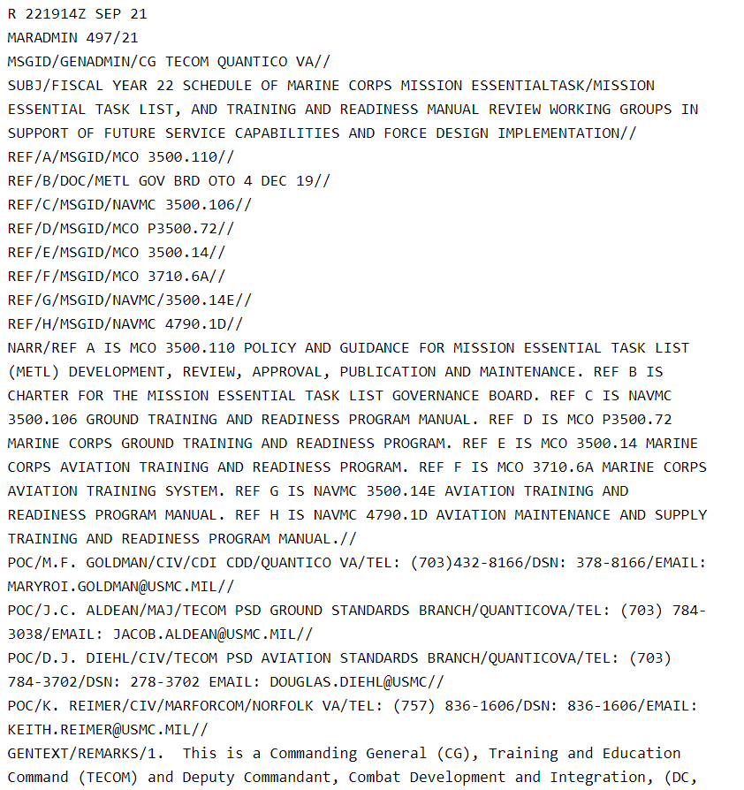
MET / METL Review Process
(MCO 3500.110)
Staffing Developed Deliverables to Implementation
M-90: MCTL Branch contacts Lead Stakeholder, confirms dates/location.
Info: METL Office, TECOM, FMF.
M-60: Lead Stakeholder coordinates attendees w/OpsO/Ops Chiefs.
If live, arranges for location. Coordinates access requirements.
Info: MCTL Branch, METL Office, TECOM, FMF.
M-45: METL Office creates MSOutlook TEAMS site/Telecon line.
M-30: Coordination Telecon (MCTL, METL, Lead Stakeholder, TECOM).
METL WG: Lead Stakeholder chairs. METL Office facilitates. MCTL Branch / TECOM provide leveling and supports review. FMF units attend.
M+5: METL WG products staffed by METL Office (AO Level via e-mail).
M+30: Draft METL staffed by METL Office (O-6 level via TMT).
M+60: METL Office consolidates O-6 inputs. Adjudicated products provided to MCTL Branch, Lead Stakeholder, FMF, and TECOM.
Quarterly: METL Governance Board (MGB) receives WG results/status update.
Post MGB approval:
MCTL Branch updates MCTL/MCTIMS as required
METL Office loads METL via MCTIMS
I&L reviews nominations for MEE
PP&O Readiness updates Units of Employment/Critical MOS tables
Lead Stakeholder conducts Mission Statement review
TECOM updates community training events and T&R manual
TECOM / CD&I MARADMIN
FY METL / T&R Manual
Review
Schedule
CD&I CDD MCID
MCTL Branch
PP&O – South (MFC)
METL Office
PP&O Readiness
Lead Stakeholder
(PP&O, AVN, I&L, DC I,
MCICOM)
FMF Units
(MFP/MFC/MFR)
TECOM

Slide 12
MCT/MET/METL & T&R Development Process
Adapting to Future Force Design and Modernization
MARADMIN 447/22 - FY23 Schedule of MET/METL, T&R Manual & TMT Reviews
Focus: “COIs will develop/validate METs and aligned T&R training events ISO CMC’s Force Design implementation and prioritized future service capabilities.”
Established “Current” MCT / MET / METL / Training Development Process:
What’s the unit’s mission requirement; what capabilities can the unit provide NOW?
What MET-aligned exercises and e-coded training events are conducted NOW?
Adapted “Future” MCT / MET / METL / Training Development Process:
DRAFT MCTs/METs developed from “concepts”:
  Requires Service validation to quantify TTPs and curriculum development.
  Requires defined actions/activities/capabilities derived from available doctrine (i.e., Joint, USMC or other Service).
  May NOT have existing/aligned curriculum, POI, training standards, or T&R events.
  Requires experimentation/exercises IOT determine MET-to-training feasibility.
  Are NOT officially published/available within MCTL / MCTIMS.
Validated/approved DRAFT MCTs, “Future METs”, will be incorporated within MCTL and used in the MCTIMS training modules to aid in training alignments.

Slide 13
MCT / MET / METL Development
Phases & TECOM Training Roadmap
Validates TECOM’s capability doctrine, TTPs, training references and standards-based inventory of core competencies necessary to support essential billet MOS training and education.
Supports Service/TECOM’s prioritized battle rhythms and synchronization of necessary training experimentation, events, exercises, and any necessary changes and alignments of METs to the respective community T&R Manuals.
Ensures TECOM’s curriculum, syllabus and POI development or modifications sustaining MET-defined capabilities, training and education content.
Validates TECOM’s current E-coded training events or allows NEW individual, collective or chained training event recommendations or experimentation training requirements.
Ensures “Feedback Loop” CD&I-to-TECOM to refine/modify existing training standards or create new standards.
Provides Leaders and Marines with Service-level minimum standards and resources supporting managed on the job training (MOJT) and skills progression training.

Slide 14
MCT / MET / METL Development
Improved Coordination: MCWL
Establishment Goal: To adopt an agreed methodology wherein concept development, wargaming and scenario experimentation information conducted by MCWL’s Force Design and Future Force efforts is integrated or made visible to the MET/METL and training development process.
Objective: Would ensure NEW/Future Force structure, unit repurposing and/or evolving unit formations factor “current” capability data injects (man/train/equip standards) the MET/METL/T&R Manual processes develop and maintain.
Doctrine alignments or development considerations necessary to validate future TTPs and academics development.
Concepts, once approved by Senior leadership, could provide source docs (i.e., TMEABO) to aid, guide and inform MCT/MET capability and associated training development.
Mission Statement development, ICW CDD/TFS and community stakeholder, aligns to new MCTs/METs.
Identification of required MOSs within the new formation, required to perform the future formation METs (i.e., T/O-to-MET)
  Will the new unit formation require MOS recruitment, MOS refinement or repurposing requiring coordination between M&RA and TECOM?
  What training curriculum or Formal School POIs will be required for future force formations?
  Will new unit formations have the necessary materiel, equipment or gear available within an established timeline to ensure adequate training, experimentation, simulation or physical range and field exercises associated to the future formation MET (i.e., T/E-to-MET)?

Slide 15
MCT / MET / METL Development
Workshop Goals
Select MCTs as METs and Develop COI CORE METL = 10% of the WG’s time
Determine Baseline / Advanced Capability Statements = 20% of the WG’s time
Establish Capability Output Standards = 30% of the WG’s time
Determine Unit’s Critical MOSs required to execute the capability = 10% of the WG’s time
Determine the Unit’s Mission Essential Equipment (MEE) required = 10% of the WG’s time
Determine the E-coded Training events necessary to train to the capability = 20% of the WG time
An accurate accounting of mission “essential” tasks your organization does for the fight
Overview of the baseline capability and advanced capability being provided per MET
Relevant, measurable metrics shaping the evaluation of COI readiness to execute the MET
Current TFSMS / ASR Table of Organization (T/O)
Current TFSMS / ASR Table of Equipment (T/E)
Individual Series 1000-2000 or 3000-9000 Series Collective per MET

Slide 16
MCT / MET / METL Development
PP&O DRRS Assessment Process
Defined capability statements for two levels of trained proficiency is required per MET:
  Baseline: Readiness expected from a USMC tactical unit, normally sustained through unit home station core training and achieved without requiring a DFT, dedicated at-sea training, or external MAGTF support.
  Advanced: Readiness required by specific units expected to perform a critical role in a mission or OPLAN. Typically requires external MAGTF support, ship-to-shore movement, or a Service-level or Joint training exercise.
Man/Train/Equip standards are auto-populated with assessed values drawn from ADS systems. Commanders can correct inaccurate data or input data when automatic feeds are not in place.
DRRS auto-calculates achievement of each standard via ADS populated (and/or corrected) data.
If a unit meets all “Baseline” output standards, but does not meet certain other standards, the Commander may choose to override the calculated MET assessment from “No” to “Qualified Yes”.
In order to report “Yes”, a unit must achieve all “Baseline” and “Advanced” standards.
NO
QUALIFIED - YES
YES

Slide 17
MCT / MET / METL Development
MET Baseline / Advanced Capability Statements
Per CJCSI 3401.02 Force Readiness Reporting
“Qualified Yes”: Unit can accomplish all or most tasks to standard under most conditions. Specific standards and conditions that cannot be met, as well as the shortfalls or issues impacts the unit’s inability to accomplish the task. Must be clearly detailed in MET assessment.
“Yes”: Unit can accomplish the task to established standards and conditions. The assessment should reflect demonstrated performance in training or operations.
  Challenge: What is “most”?
  Solution: USMC re-defined the assessment process to distinguish between baseline standards (equivalent to “most”) and advanced standards (equivalent to “all” established standards).
USMC DRRS
“Qualified Yes” = Baseline readiness: Level of readiness expected from a USMC tactical unit, normally sustained through unit core training at home station and achieved without requiring a Deployment for Training, dedicated at-sea training, or external support
“Yes” = Advanced readiness: Level of readiness required by specific units expected to perform a critical role in a mission or OPLAN. This level of readiness normally requires external support, ship-to-shore movement, or a Service-level or Joint training exercise. Units designated for training to this level are normally selected through the force synchronization process.
Considerations for Baseline:
Sustainment at Home Station
Sustained across most of a unit’s lifecycle
No external MAGTF support required (evaluators or attachments)
No dedicated at-sea training required
Considerations for Advanced:
Peer threat
Adversary force used for training
Degraded/denied C2 environment
Training with attachments (external MAGTF support)
Deployment for training (Arctic, Jungle, etc.)
Ship-to-shore movement / at-sea training (naval platforms or connectors)
Joint or Naval context
Complex terrain
Accelerated response timelines
Evaluated exercise or MCCRE
Example: MCT 1.6.1 Conduct Offensive Operations (INF BN)
Baseline Capability: Company-level maneuver to seize maritime terrain objectives in support of naval operations.
Baseline Outputs: Coordinated company attacks, destroy an enemy force, of company strength, in prepared defensive positions. Exercise C2 and signature management across all expeditionary sites. Employ aviation-delivered fires.
Advanced Capability: Synchronized company-level maneuver to seize maritime terrain objectives defended by a peer adversary, in complex terrain, in a contested and/or degraded command and control environment.
Advanced Outputs: Integrate naval and joint fires into the scheme of maneuver. Synchronized company-level maneuver in complex terrain. Prepared positions / complex obstacles. Explosive hazard / improvised threat environment. Contested / C2D2 environment. Externally evaluated live exercise with naval force participation and a peer enemy force within the last 12 months.

Slide 18
MCT / MET / METL Development
Virtual MET / METL Review Workshop Deliverables
Per DOD COVID and restricted TAD guidance, METL Review Workshops were conducted virtually beginning FY20 using MSOutlook TEAMS collaborative environment.
TEAMS continues to provide tools to aid in reviews.
Physical Reviews will be scheduled as noted within MARADMIN for FY23 MET/METL & T&R Reviews
Virtual Reviews:
Reviewed current and updated Core METs of the unit METL
Determined or revised Baseline and Advanced capability statements
Developed standards for each MET:
  Identified critical MOSs necessary to execute the METs
  Identified mission-essential equipment (MEE) necessary to execute the METs
  Developed MET training standards aligned with updated T&R manuals
Captured C-IED training requirement into Baseline standards for at least one MET of unit METL
Capture live Amphib exercise in Advanced standards for at least one MET
Identified Units of Employment (UE)* standards
  *UE is the level at which a unit generates forces for deployment, normally the building blocks of standard task organization.
Identified supporting/subordinate unit necessary to achieve defined MET capability.
Determined staffing requirements, internal and external, of developed deliverables.
18

Slide 19
MCT / MET / METL Development
Results & Approvals
REVIEW WORKSHOP
CONSIDERATIONS
  TECOM / CD&I FY MARADMIN announces coordinated MET/METL / T&R Manual / TMT Reviews per Service priority.
  COIs may request MCT/MET refinement, change, or modification that addresses mission or structure change, resource or training requirements or deficiencies.
  **Virtual collaborative tools during COVID enabled shortened cycle ensuring participation consistency.
  “Current” unit capabilities, manned and resourced, supports current mission requirements.
  “Future” Force Design developed METs are NOT incorporated into current Core METLs but can assist TECOM in necessary experimentation, curriculum and training roadmap development.
  MCT/MET changes requires stakeholder coordination across echelons.
PROCESS CONTROL
ENDSTATE
COI Mission Statement should support chosen METs.
Workshop “data-driven” deliverables receive stakeholder visibility through staffing.
Identified capabilities/tasks, w/training aligned to the T&R Manual, and man/equip/output standards, provides a Commander the adequate ability to build a Training Plan and to assess his unit’s METL readiness in DRRS.
Developed deliverables with Record of Proceeding (ROP) is staffed via TMT for proper COI and HHQ review. GO-Level staffing sometimes required.
CD&I/CDD/MCID facilitates new / modified MCT changes within MCTIMS Task Master for immediate use as a reportable MET.
Approved FMF METs ISO RFF/RFC, Force Mgmt./ Global Force Synch processes are facilitated through MCTIMS and interfaced to DRRS.
CD&I’s collaborative/coordinated process codified per MCO 3500.110
Notes:
19

Slide 20
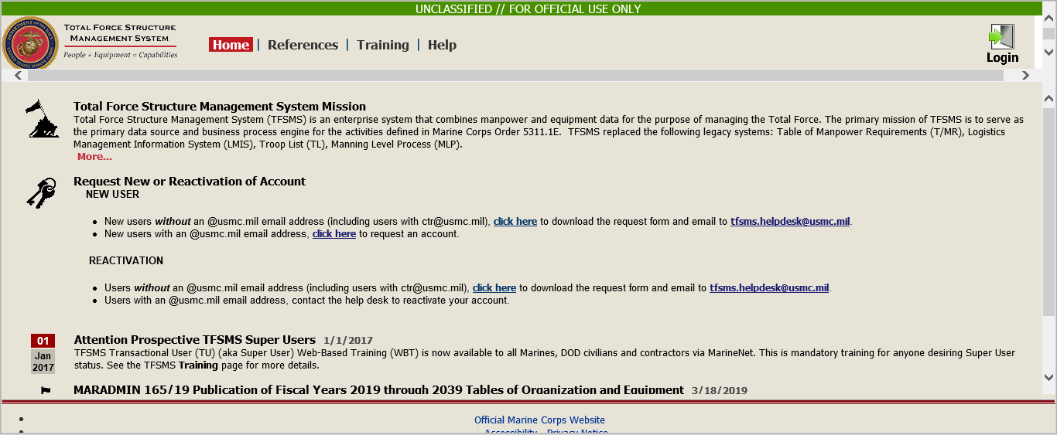

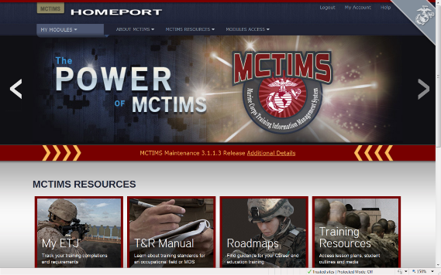
MCT / MET / METL Development
Mission Statement, T/O&E and Training Alignments
Personnel Standards/Critical MOS
AAV BN Critical MOS | MCT 1.1.2 Provide Forces | MCT 1.4.1.1 Conduct Breaching Operations | MCT 1.6.1 Conduct Offensive Operations | MCT 1.6.4 Conduct Defensive Operations | MCT 1.12.1 Conduct Amphibious Operations | MCT 5.3.2 Establish Means for Command and Control
1803 AAV Officer | X | X | X | X | X | X
2141 Amtrac Repair/Tech | X | X | X | X | X | X
2841 Systems Repairer | X | X | X | X | X | X
0621 Field Radio Operator | X | X | X | X | X | X
0651 Cybernet Ops | X |  |  |  |  | X
8404 Corpsman | X | X | X | X | X | X
Equipment Standards/MEE
MEE TAMCN | NOMEN-CLATURE | MCT 1.1.2 Provide Forces | MCT 1.4.1.1 Conduct Breaching Operations | MCT 1.6.1 Conduct Offensive Operations | MCT 1.6.4 Conduct Defensive Operations | MCT 1.12.1 Conduct Amphibious Operations | MCT 5.3.2 Establish Means to Command and Control
B1315 | Launcher, MK-154, MOD 1 |  | x
E0796 | AAV, C4, AAVC7A1 | x |  |  |  |  | x
E0846 | AAV, Personnel, AAVP7A1 | x | x | x | x | x | x
E0856 | AAV, Recovery, AAVR7A1 | x
Training Standards
TRAINING EVENTS | MCT 1.1.2 Provide Forces | MCT 1.4.1.1 Conduct Breaching Operations | MCT 1.6.1 Conduct Offensive Operations | MCT 1.6.4 Conduct Defensive Operations | MCT 1.12.1 Conduct Amphibious Operations | MCT 5.3.2 Establish Means to Command and Control
AAV-CSS-7002 Conduct Recovery and Evacuation Operations |  | X | X | X | X
CIED-OPS-7001 Operate in Environments with an IED Threat |  |  | X | X
AAV-CSS-6001- Employ Combat Trains |  |  | X | X
AAV-CBST-5001 Support a Breach |  | X
MET/METL Review process ensures Alignments
to improve data integrity interfaced to DRRS.

Slide 21
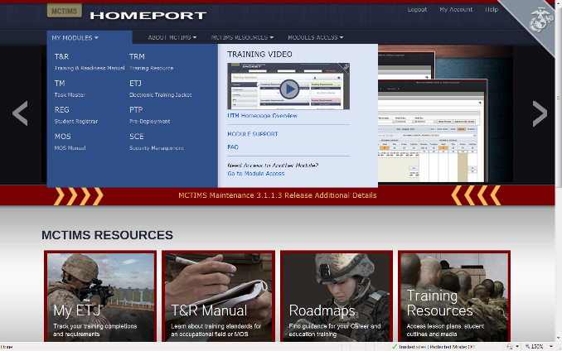
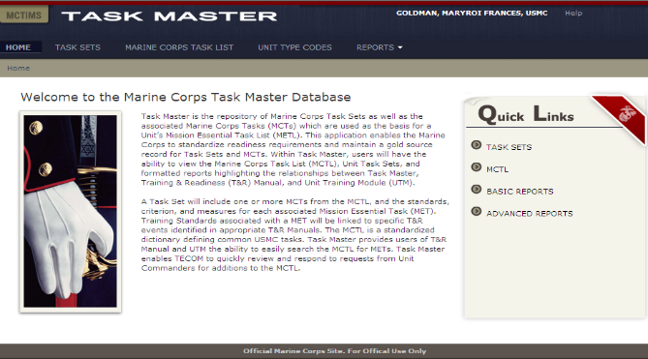
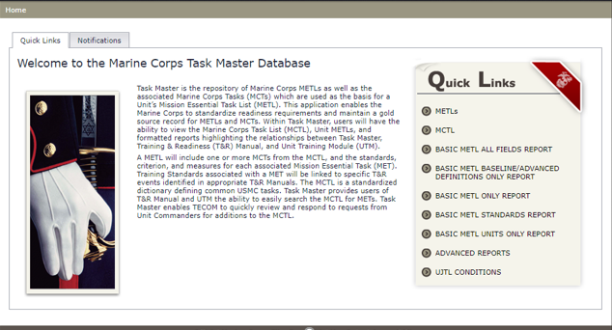
MCTIMS Task Master
ADS for MCTL / METs / METLs
MY MODULES
TM
TASK MASTER
21

Slide 22
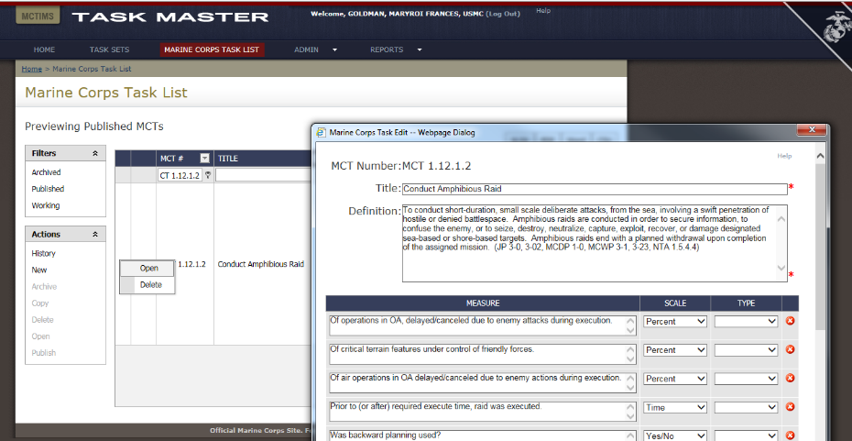
MCTIMS Task Master
Marine Corps Task List

Slide 23
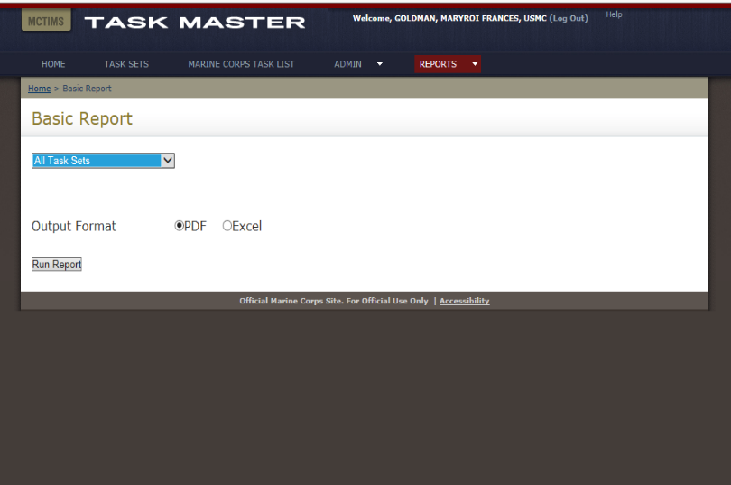
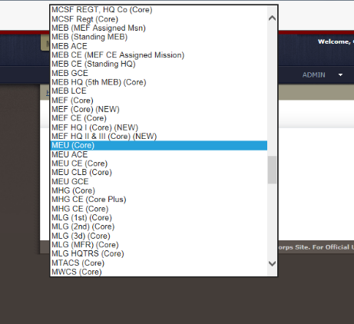
MCTIMS Task Master
Task Sets/METLs / Community Reports

Slide 24
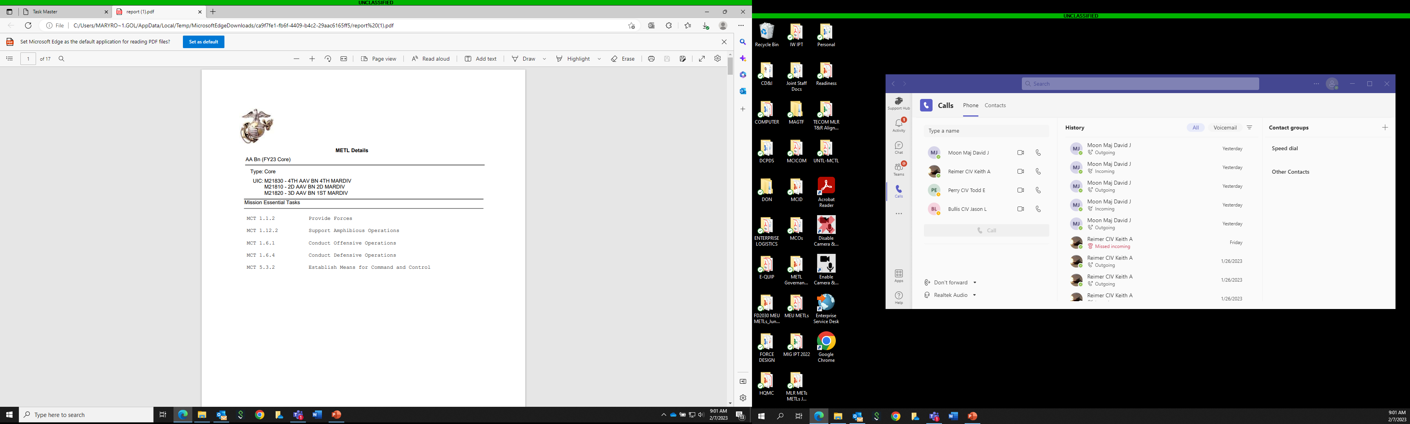
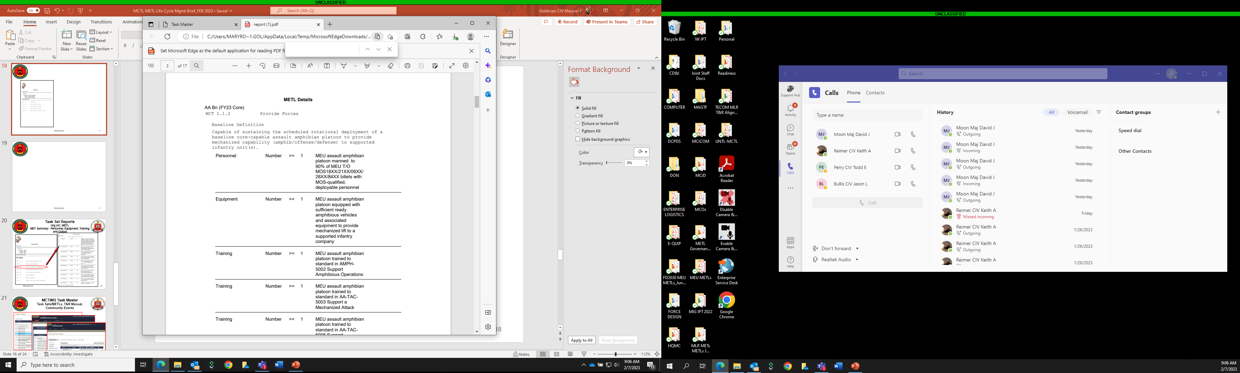

METL Reports
Org UIC, METL
MET Summary: Baseline Capability Statement, Personnel, Equipment, Training and Output

Slide 25
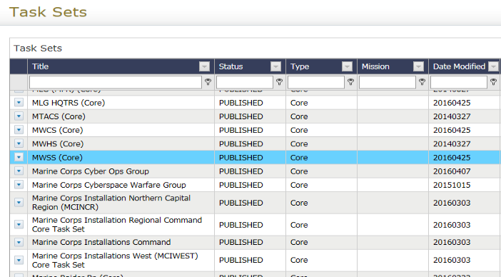
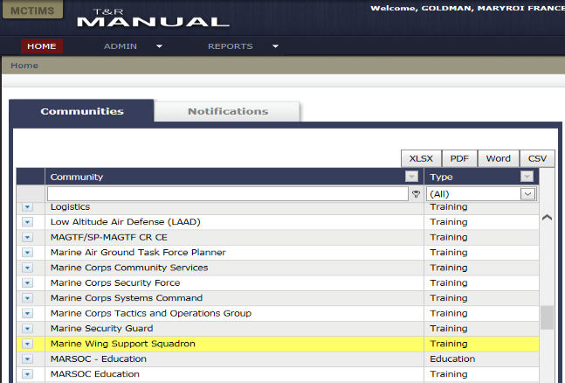
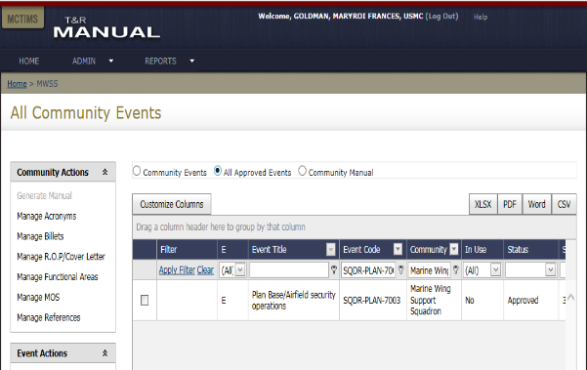
MCTIMS Task Master
Task Sets/METLs, T&R Manual, Community Events
MWSS T&R Manual (NAVMC 3500.117)
Training Events

Slide 26
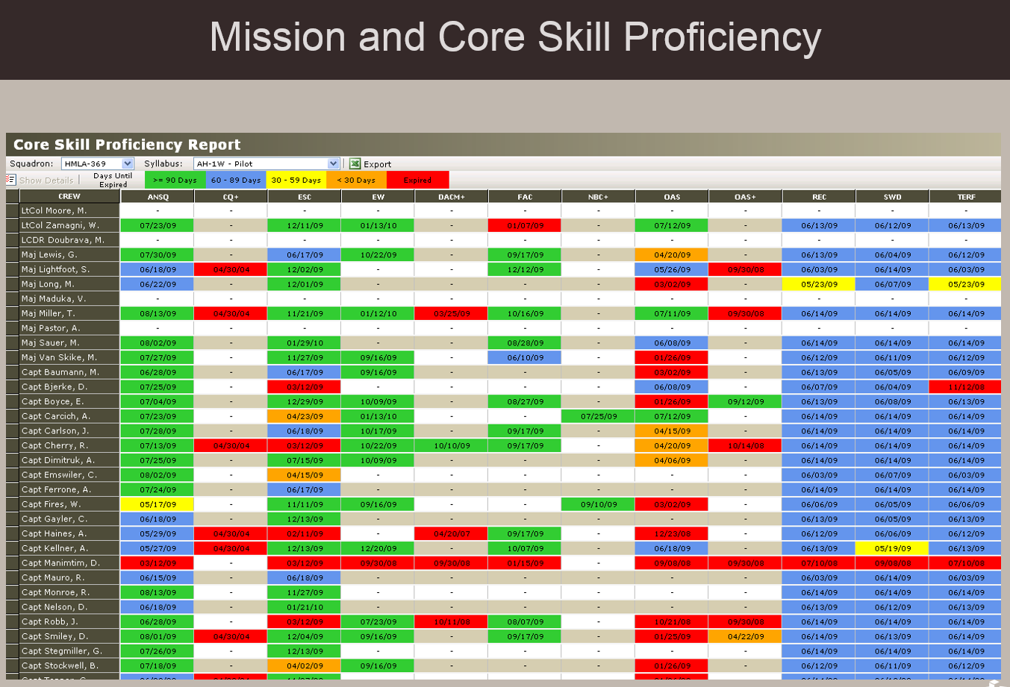
MSHARP
USN/TECOM Aviation Training & Readiness System
MSHARP Modules:
Flight Logger
Aircrew Logbook
Individual Qualifications (Admin)
Individual Qualifications (Flight)
Individual Event Proficiencies
METs/Mission and Core Skill Proficiency
SBTP / Formation
Simulator Management
Simulator Scheduling
Simulator Utilization
Unit Flight Scheduling
Resource Availability
Sortie Based Training/Flight Hour Program
Flt Leadership
TMR Codes
T&R Codes
Approaches
Landings
Ranges
Ordnance
FAC(A) Controls
Passengers / Cargo
Hoist / Fuel Reports

Slide 27
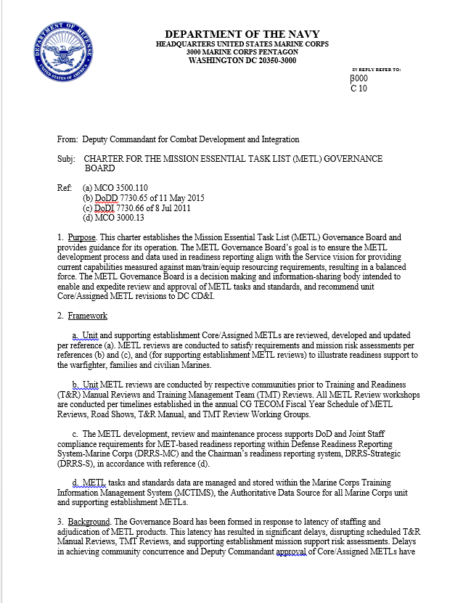
CD&I / CDD / MCID
METL Governance Board
Purpose:
Ensures the METL development process and data used in readiness reporting aligns with the Service vision for providing current capabilities measured against man/train/equip resourcing requirements, resulting in a balanced force.
Acts as a decision making and information-sharing body intended to enable and expedite review and approval of METs/METLs and associated standards, and recommend unit Core/Assigned METL revisions to DC CD&I.
Objective:
Accelerate integration/approval of FMF/SE METs/METLs and mitigate METL man/train/equip/output data imbalances would could impose risk or adverse impacts on force sourcing requirements.
Provides leadership with timely and accurate METL data to resource and sustain a ready force that meets current CCMD/CCDR force support requirements.
Forum to address MET-based sourcing, synchronization of METL products w/adjacent USMC authoritative data for timely interface to DRRS-MC.
Support Service goal of sustainable and efficient readiness reporting.
Chartered 2019 by DC, CD&I
Organization and Membership:
Reps from HQMC, MARFORs, MEFs, FMF, and SE. Chaired by CD&I/CDD/MCID. Co-Chairs will assign O-6 level reps to participate with additional subject matter expert (SME) representation as required.

Slide 28
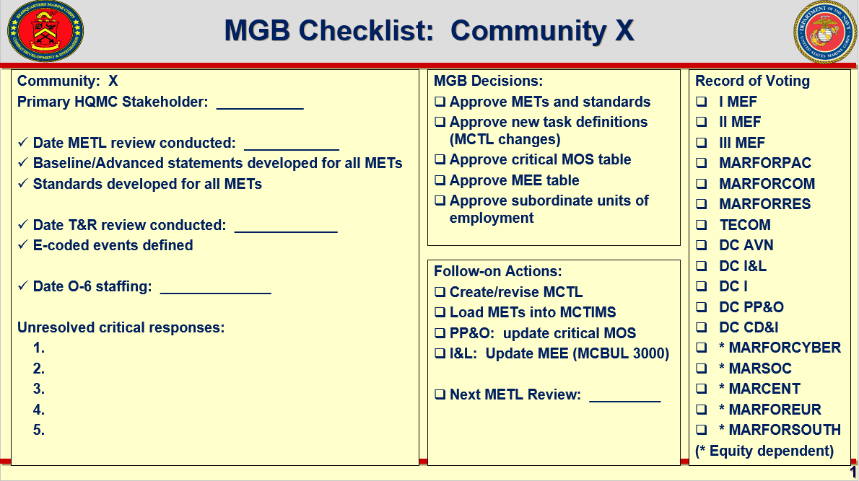
CD&I / CDD / MCID
METL Governance Board
Organization and Membership:
Reps from HQMC, MARFORs, MEFs, FMF, and SE. Chaired by CD&I/CDD/MCID.
Co-Chairs will assign O-6 level reps to participate with additional SME representation as required.
Adjudicate METL review comments / recommendations
Capture Decisions / Align Supporting Actions

Slide 29
CD&I’s MCT/MET Life Cycle Supports
GFM RFF Readiness Synchronization
Codified Governance Policies:
MCO 3000.13 (2020) Readiness Reporting (DRRS) SOP
MCO 3500.110 (2011) MET/METL Development
MCO 3502.6A (2013) Marine Corps Force Generation Process
MCO 3501.1D (2019) Marine Corps Combat Readiness Evaluation (MCCRE)
MCO 1553.10 (2014) Marine Corps Training & Info Mgmt (MCTIMS) SOP
MCO 3120.12 (2015) Global Force Management and Force Synchronization
D-360
1
GFM RFF/RFC - PP&O Mission Review / Apportionment / FMF Sourcing Selection
2
MCTIMS - MET/METL Developed Products
D-180
3
MARFOR Review
PP&O Validation
MCTIMS METL Data Interface to DRRS
Track Readiness Assessments
4
PTP
ITX/MRX
D-30
MARFORs, ISO assigned COCOMs/CCDRs, registers FMF capability and mission resource requirements via RFF / RFC to PP&O.
Approved MET/METL Review Workshop developed Core METLs and standards within MCTIMS for immediate use by deployable units.
PP&O validates Assigned METLs to requesting MARFORs / MEFs and conducts pre-deployment unit readiness synch per mission requirements.
Necessary PTP / Exercises / Evals / Certification validations and timelines are completed and coordinated.
MCCRE
Certification
D-1
Deployment

Slide 30
MCT / MET Alignments/Linkages
DRRS-S (DoD / JS / OSD / Chairman’s Readiness System)
JMETs/JMETL
Links to Service Components METs/METLs
Supported
CCMD/CCDR
USMC METL
MARFOR
MCT 1.1 Generate Forces
MEF/MEU/MEB
MCT 1.3.1 Conduct Maneuver
“Tasks”/ METs link
Top Down / Bottom Up
Bottom Up / Top Down
Marine Division
MCT 1.6.4 Conduct Defensive Ops
Infantry Regt HQ
MCT 5.7.4 Plan and Direct Defensive Ops
Infantry BN
(Subordinates)
MCT 1.6.4 Conduct Defensive Ops
MCT 1.7 Support Maneuver Through the Provision of Training Areas
MCT 4.6.6 Community Services
MCT 4.1 Conduct Supply Operations
MCT 4.3 Conduct Transportation Operations
MCT 4.6 Provide Services (Nonmaterial & Support Activities)
MCT 4.6.3 Provide Airfield Operation Services
MCT 4.9 Provide Base and Station Facilities and Related Infrastructure
MCT 6 Protect the Force
MCICOM
--MCIWest (I MEF)
--MCIEast (II MEF)
--MCIPac (III MEF)
--MCI-Regional
Installations / Bases / Stations METLs provide Supporting Establishment / Infrastructure and Support Programs

Slide 31
DC PP&O’s
Institutional Readiness Working Group (IRWG)
Plans, Policies,
& Operations
Purpose: Forum employing existing USMC processes, to address current/future institutional readiness and provide recommendations for mitigation when imbalances impose Risk-to-Force or Risk-to-Mission.
Endstate: Facilitates a unified approach to informing Senior leaders in the areas of institutional readiness and ensures MC maintains a sustainable “Ready Force” to meet OPLAN demands.
Current Support: Force Synch.Conf, Force Mgmt Summit, Quarterly Readiness (QRB) to the CMC.**
Future Support: Determining predictive and forecasted readiness challenges to satisfy CMC’s prioritized guidance for Future Force Design implementation.
Membership: All DCs, MARFORs, MEFs, LOGCOM, MCICOM, DIRINT, DIR-C4, CG TECOM and MARCORSYSCOM. CDD/COPS & MCID/Plans MCTL Branch Lead AOs.
Method:
Monthly AO, O-6, and ESG-IRWG (1-Star GO) Meetings or SVTC to address issues, actionable items and develop/review/refine information, COAs and mission risk slides for the QRB to the CMC.
Director CDD is 1-Star GO Representative on ESG-IRWG.
**Data presented validates current unit readiness or illustrates shortfalls requiring future force solutions and mitigation strategies with institutional commonality.

Slide 32
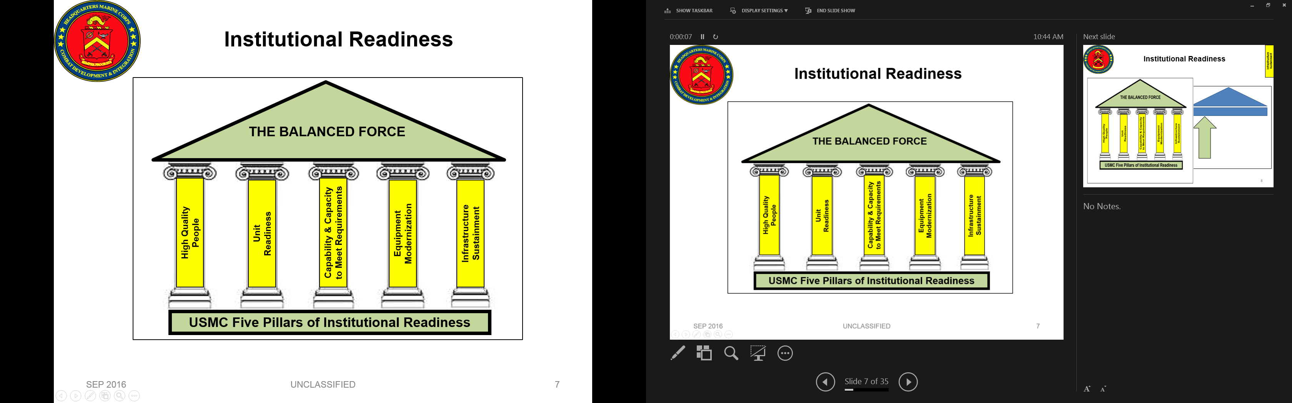
MCTs/METs/METLs, Capability Development Processes and PPBE**
NSS
NDS
38th CMC CPG
Operating & Functional Concepts
CURRENT METs/METLs
FUTURE METs/METLs
DPG
NMS
Force Development & Integration Strategic Plan
Approved P&R Assessment
QDR
MCID GOALS:
--Ensure “CURRENT” capabilities (“METS”), supports “FUTURE” capabilities planning and requirements development cycle IOT build / resource adequate man/train/equip requirements.
--Identify capability deltas, gaps and solutions via deliberate Future Force capability and wargaming processes to improve METs/standards, or, aid in developing “Future” MCTs/METs utilized by the Future Force.
Force Design Annual Report (FDAP)
P&R
(PA&E)
FY-26+
PB-22-23
Guidance
CD&I/CDD, OAD and Futures Directorates
Assessment
End of FY
Force Design
METs / METLs
DRRS-MC
MCCL
MAGTF Wargames
OPFOR / SE
Execution
MCGL
POM-25
CD&I / CDD
PB-23
MCSDD
Planning
Front End Assessment
MCCIP
CD&I / CDD (MCID MCTL & TFS)
CD&I “PLAN”
Program Reviews
Budgeting
Programming
= MROC
FY-23-24
POM
POM-24
= Document
P&R
MARCORSYSCOM
= Transition
P&R
Inside=Output;Outside=Input
**“We cannot let our focus on near-term availability consume the resources necessary to generate truly relevant Future Force readiness through adaptive modernization.”
Gen.David Berger, 38th CMC (2021)

Slide 33

Support
MCTL Products:
MCCDC / CD&I Web Portal: https://mccdc.usmc.afpims.mil/Units/Marine-Corps-Task-List/
Marine Corps Training & Information Management System (MCTIMS) Task Master Module:
https://mctims.usmc.mil/TNRManual/TaskMaster/Pages/Home.asp
MARYROI GOLDMAN, CIV-GS14
MCTL Branch Head
Office of Strategic Management
Marine Corps Integration Division-Plans
HQMC CD&I / CDD
(703) 784-4719 / DSN 378-4719
Maryroi.goldman@usmc.mil
Maryroi.Goldman@usmc.smil.mil
MARIO MARTINEZ, CIV-GS13
MCTL Branch Program Assistant
Office of Strategic Management
Marine Corps Integration Division-Plans
HQMC CD&I / CDD
(703) 432-8609 / DSN 378-8609
Mario.a.martinez2@usmc.mil
Mario.Martinez@usmc.smil.mil

